Slide 1
#1: Project Setup and Player Animation

Slide 2
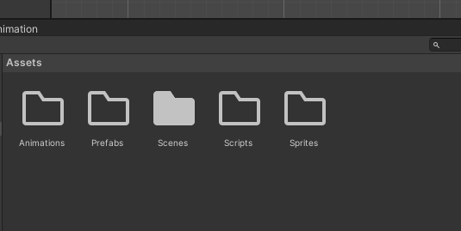
Open Unity Hub
New Project
Select 2D under the Core options
Name Project: (LastName-Section-2DSpaceShooter)
----------------------------------------------------------------------------------------------
Once Unity is opened, create these folders in the Assets folder:
Animations, Scripts, Sprites, Scenes (Already exists), Prefabs

Slide 3
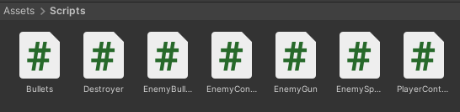
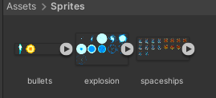
https://github.com/jericodct/unity-space-shooter
Drag the Scripts from GitHub to your Scripts Folder in Unity
Drag the Sprites from GitHub to your Sprites Folder in Unity

Slide 4
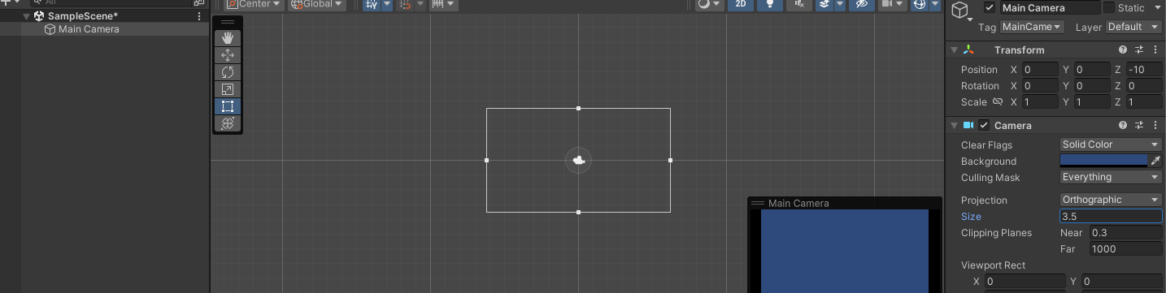
Change the size of the camera: 3.5
Change the Background to the color you prefer

Slide 5
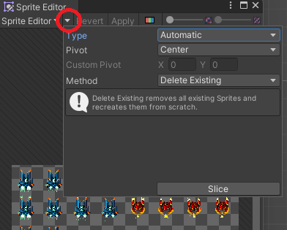
Setup your sprites
Choose “spaceships” sprite, then go to Inspector. Apply this settings:
Sprite mode: Multiple
Filter mode: Point (no filter)
Click on “Sprite Editor”
Edit and change the Type to: “Grid By Cell Size”. Edit the Pixel Size to:
X=72 , Y= 72
Click Slice to finish the setup
Click Apply

Slide 6
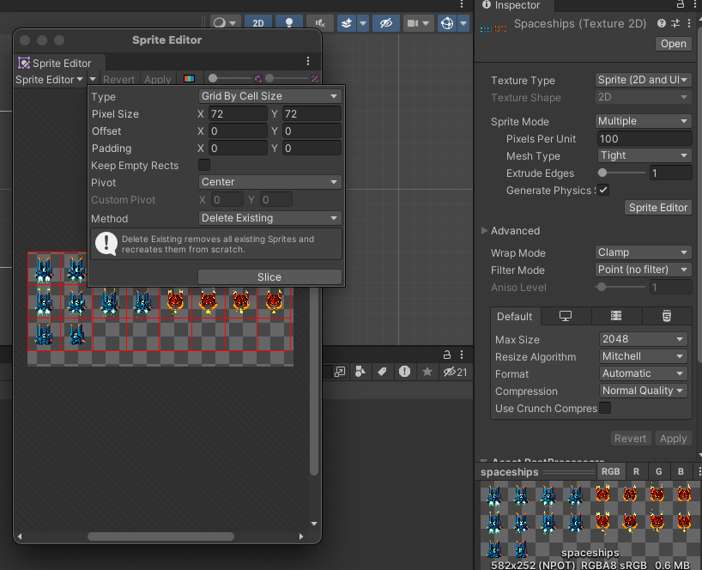
Reference:

Slide 7
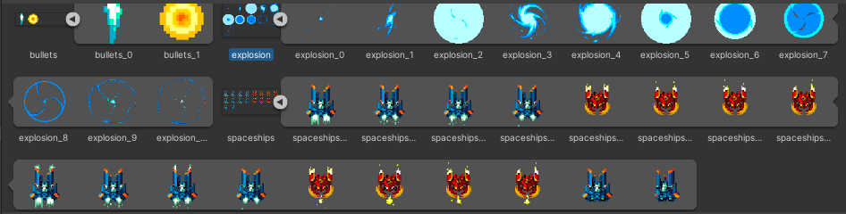
Do the same editing to the other two sprites:
Bullets
X=24 , Y=24
Explosions
X=120 , Y=120
You should have this same sprite setup (click on the arrows to see changes):

Slide 8
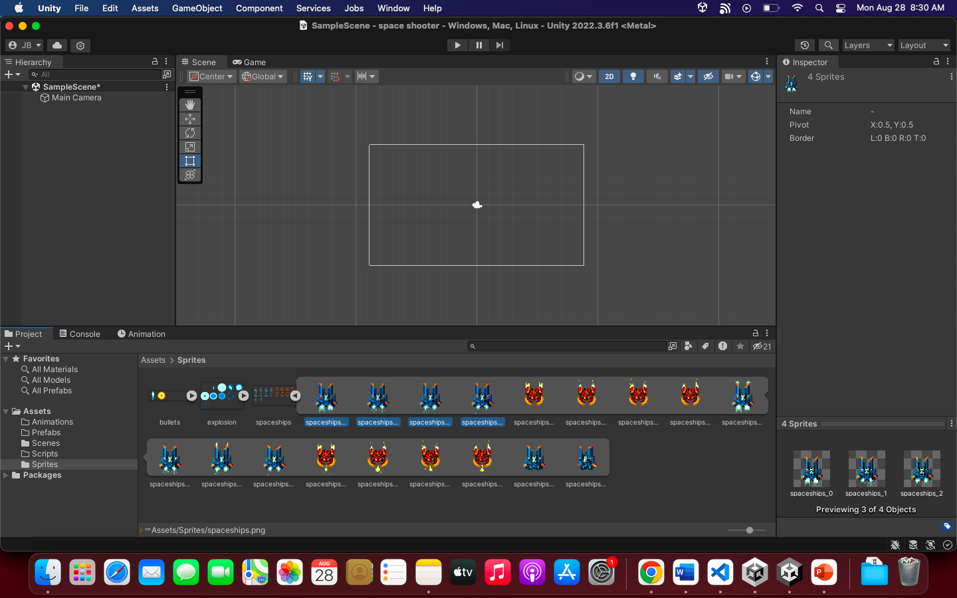
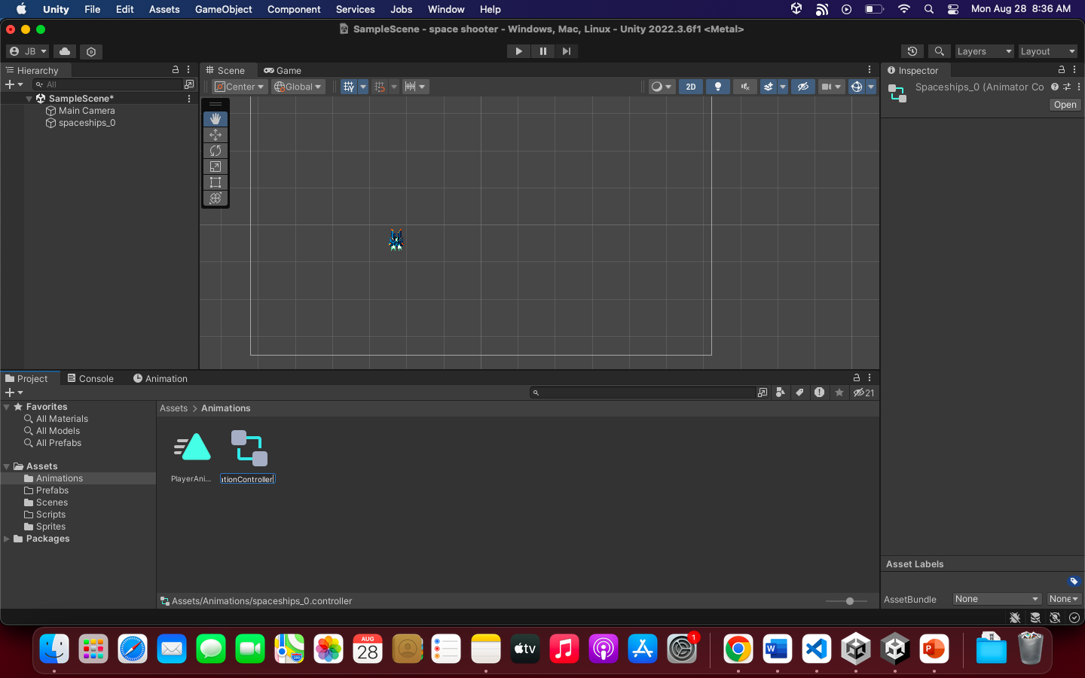
Finally, select spaceship then select the sprites as shown below:
Drag the selected sprites to the Scene View.
Animation will be created. Name it: PlayerAnimations. Save it to Animation Folder
Name the controller to: PlayerAnimationController

Slide 9
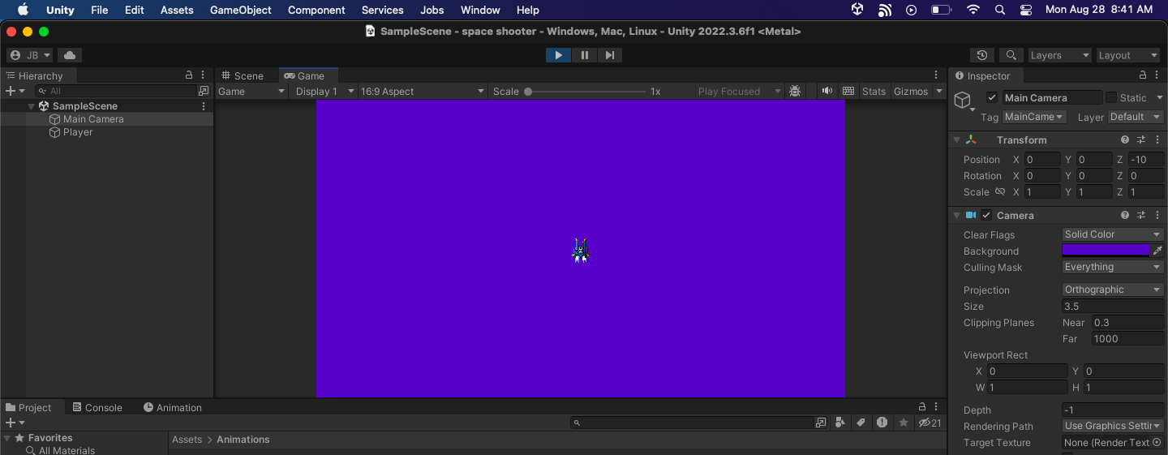
Test
Rename the dragged sprite/game object to “Player”
Reset the position of the Player
It should be centered
Run the game, you should see the Jet is animated:

Slide 10
#2: Player Input Movement

Slide 11
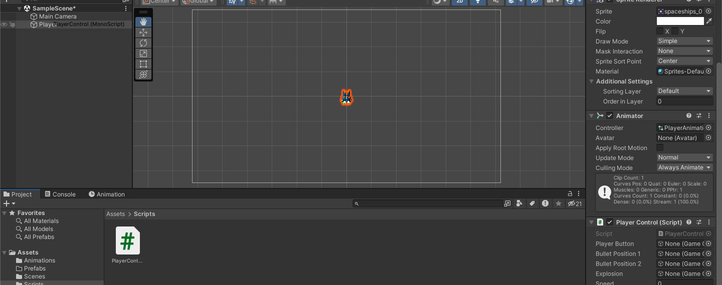
Make the Jet move
Drag the PlayerControl.cs script to the Player (Game Object)
Set the speed to “5” in the Inspector
RUN the game

Slide 12
#3: Player Bullet and Shooting

Slide 13
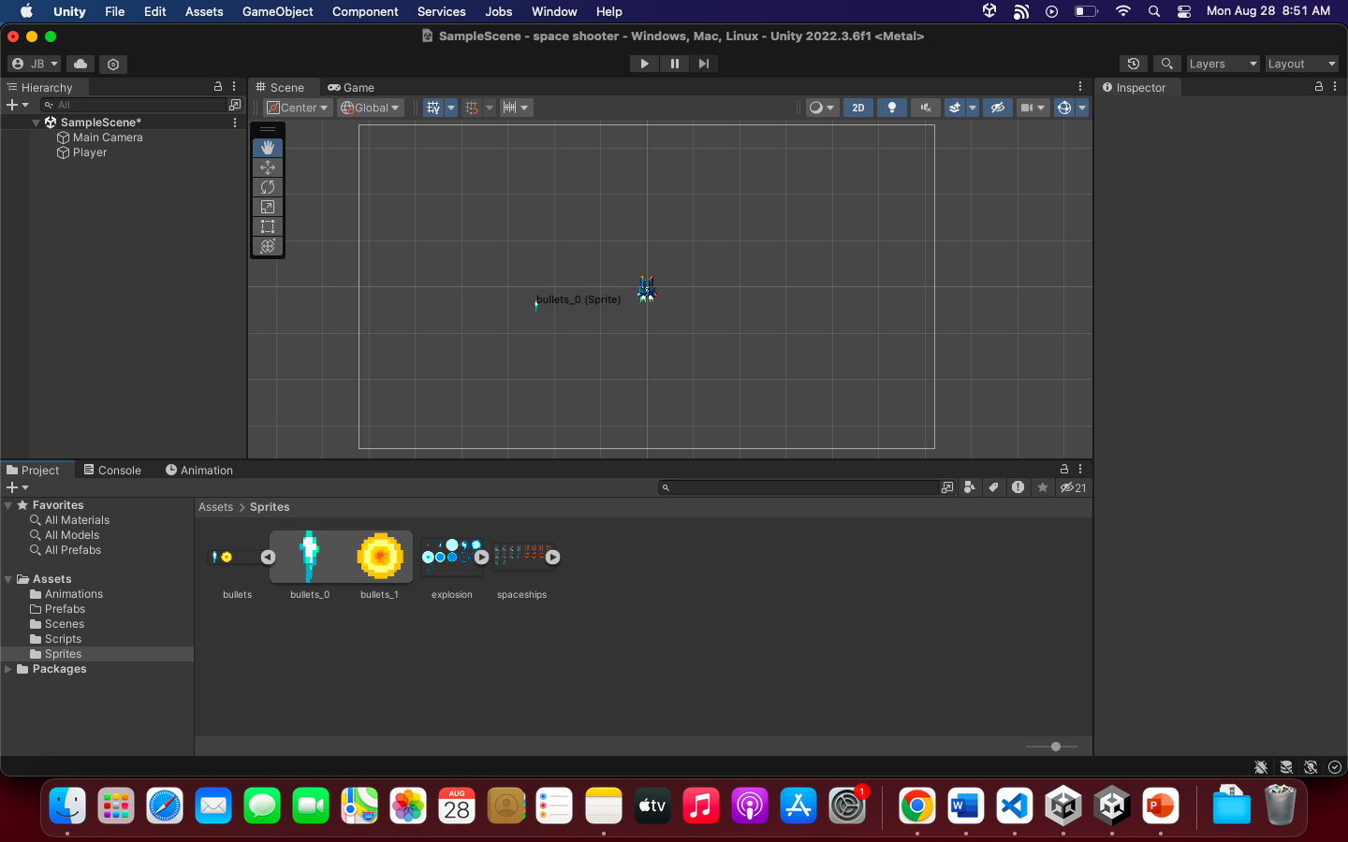
Setup Bullets
Select the Bullets sprite. Select the “bullets_0”
Drag it to the Scene view
Rename the game object to “Bullets” in the Hierarchy
--------------------------------------------------------------------------------------
Drag also the script: “Bullets.cs” to the Bullets game object
See the reference you should have by now:

Slide 14
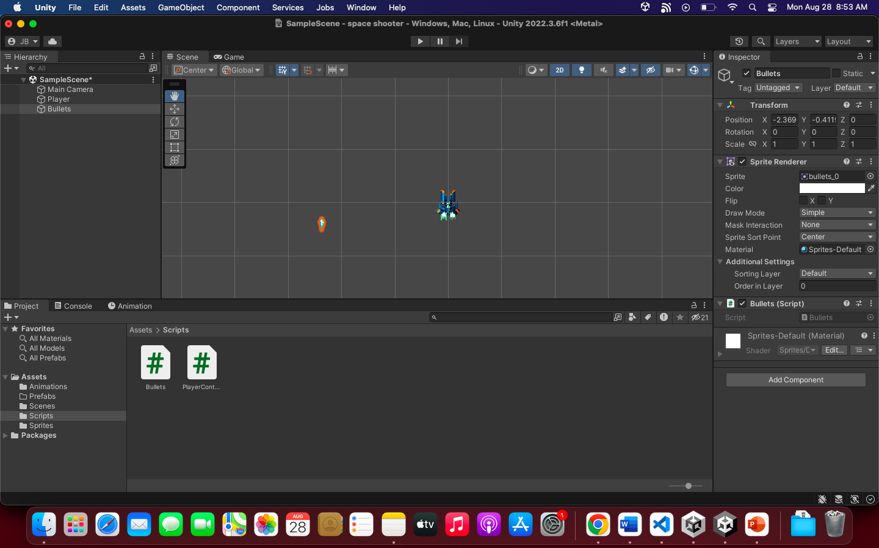

Slide 15
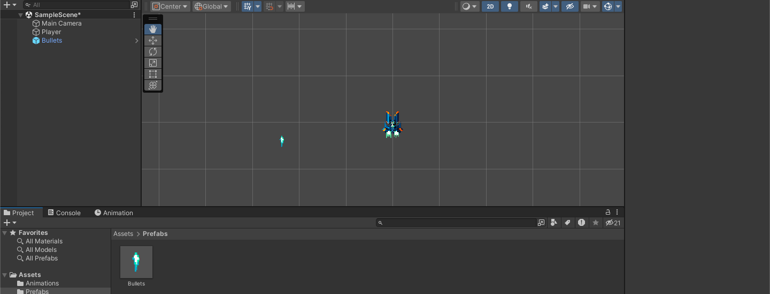
Make the Prefab
DRAG the Bullets game object in the Hierarchy to the Prefabs folder
Delete the Bullets in the Hierarchy

Slide 16
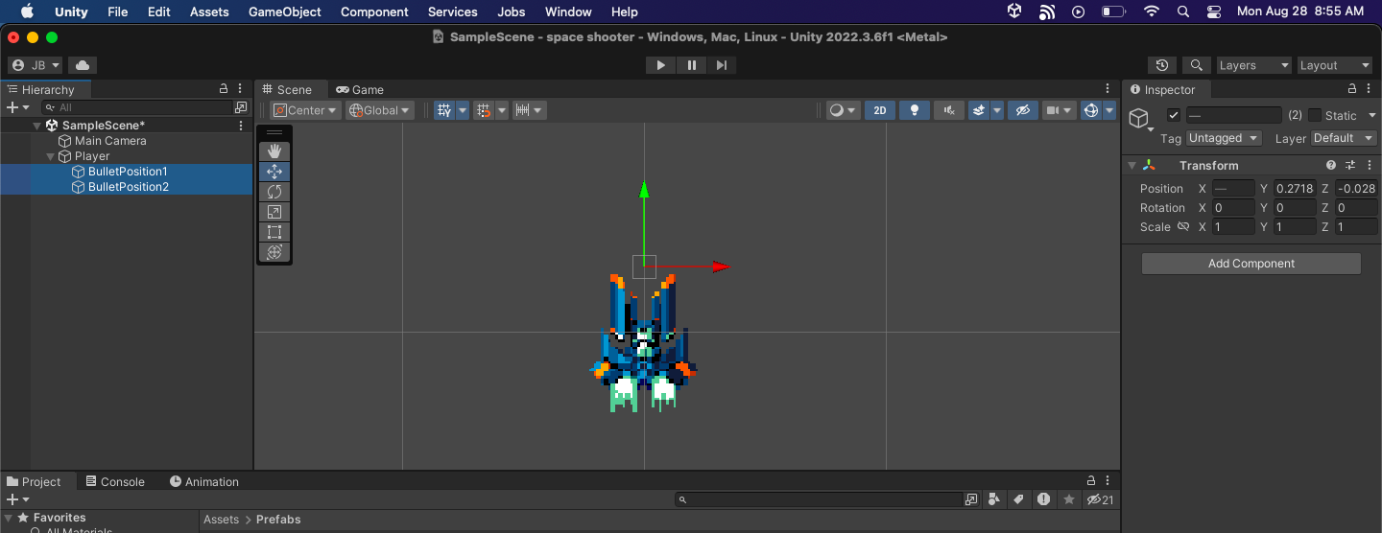
Setup Bullet’s Positions
Create to Empty Game Objects:
BulletPosition1
Position: X: -0.097 Y: 0.271889 Z: -0.02871718
BulletPosition2
Position: X: 0.094 Y: 0.271889 Z: -0.02871718
Drag the two bullet positions under Player. Creating a layer.
These should be the position of the Bullets. See image:

Slide 17
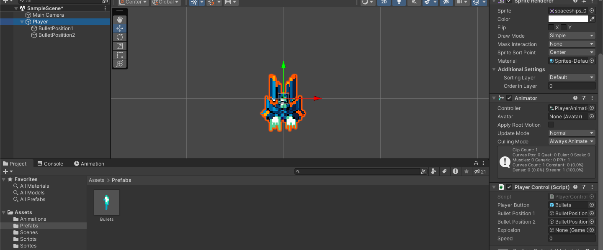
Click the Player game object
DRAG the Prefab Bullets, Bullet 1 and 2 Positions to the Script of the Player

Slide 18
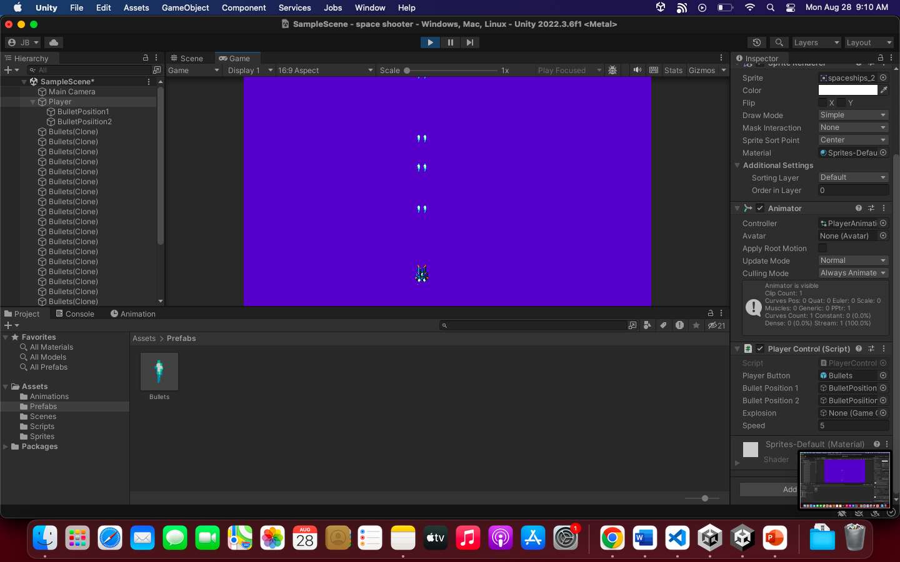
Run the game

Slide 19
#4: Enemy

Slide 20
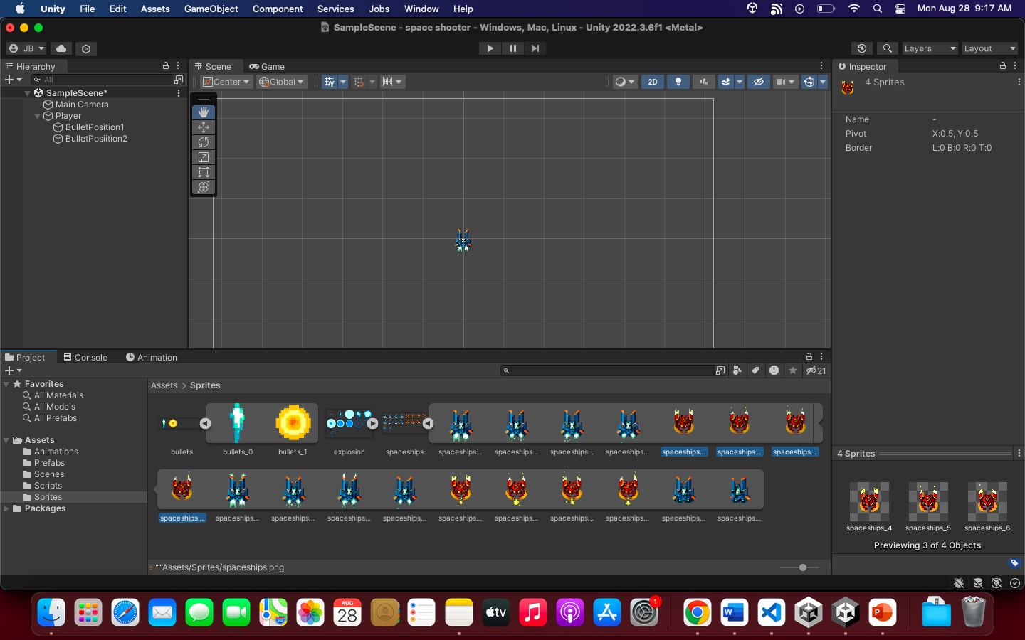
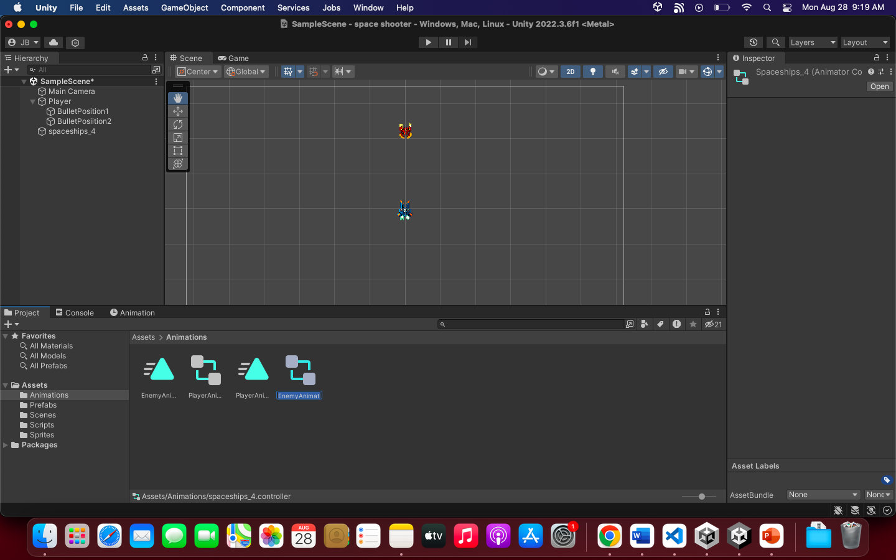
Select spaceship, then select the sprites of the enemy, as shown below:
Drag the selected sprites to the Scene View.
Animation will be created. Name it: EnemyAnimations. Save it to Animation Folder
Name the controller to: EnemyAnimationController

Slide 21
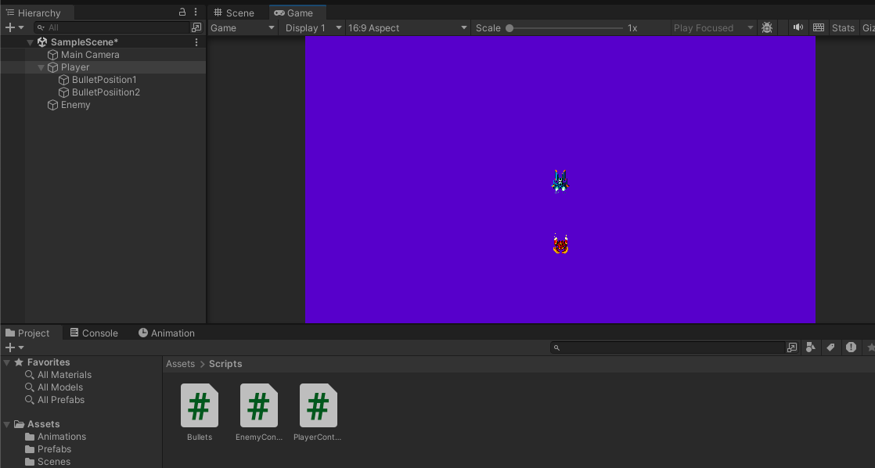
Enemy Setup
Rename the dragged sprite/game object to “Enemy”
Drag the “EnemyControl.cs” to the Enemy game object
Run to test if the Enemy moves downward.

Slide 22
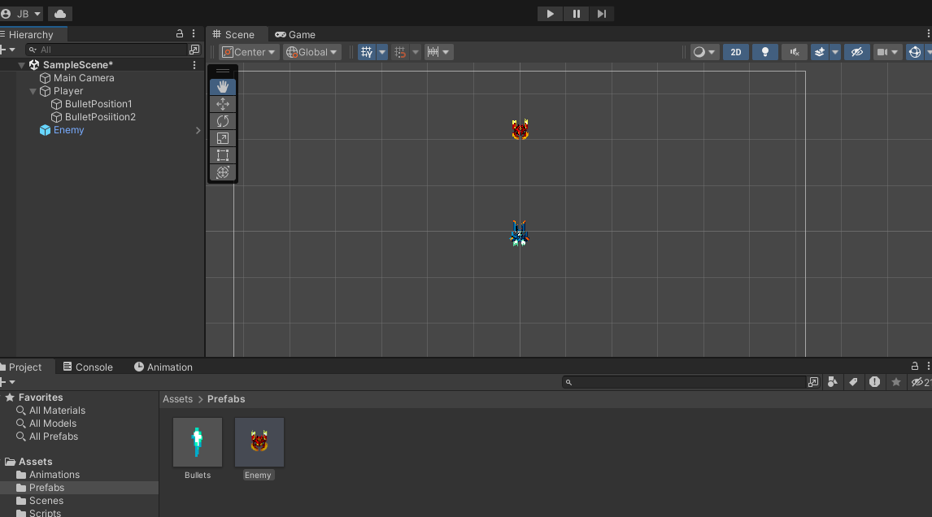
Prefab
Drag the Enemy game object to the Prefabs folder to make it as a Prefab
Delete the Enemy game object in the Hierarchy because it’s already a prefab

Slide 23
SPAWNER
Create an empty game object and named it: EnemySpawner
Position it anywhere else or Reset the position
Drag the “EnemySpawner.cs” to the EnemySpawner Game object
In the Inspector, there’s a slot of Enemy. Therefore, DRAG the Enemy Prefab to the slot:
See image reference:

Slide 24
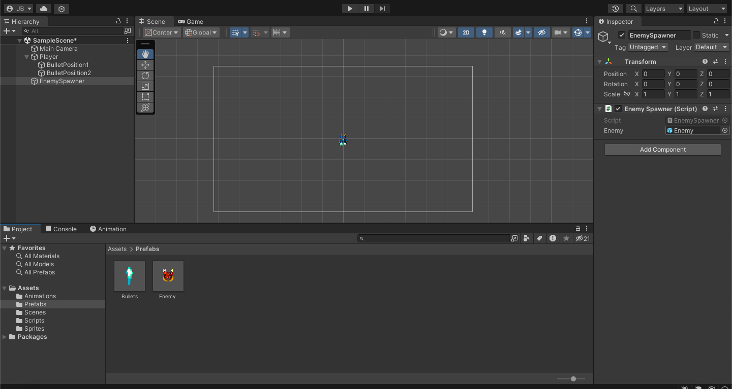

Slide 25
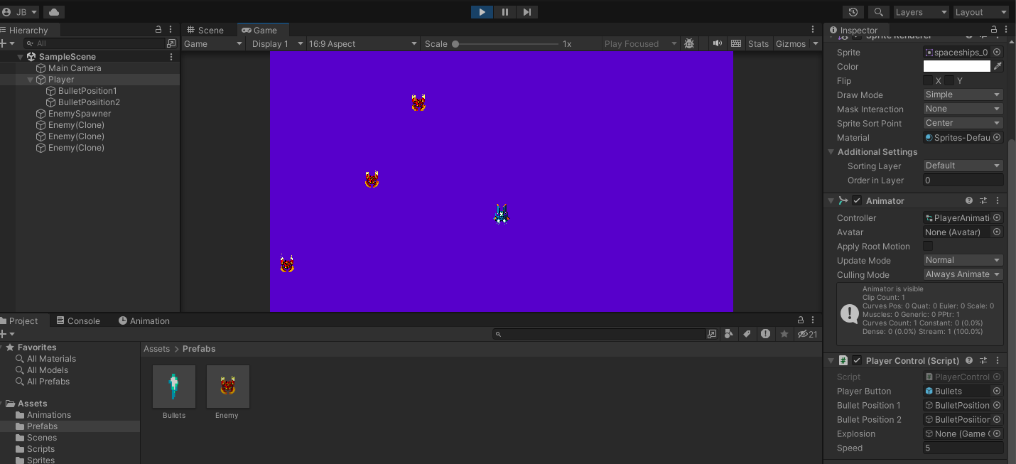
TEST IT!

Slide 26
#5: Enemy Bullet

Slide 27
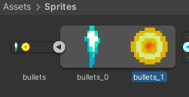
Setup Bullets
Select the Bullets sprite. Select the “bullets_1”
Drag it to the Scene view
Rename the game object to “EnemyBullet” in the Hierarchy
--------------------------------------------------------------------------------------
Drag also the script: “EnemyBullets.cs” to the EnemyBullet game object
See the reference you should have by now:

Slide 28
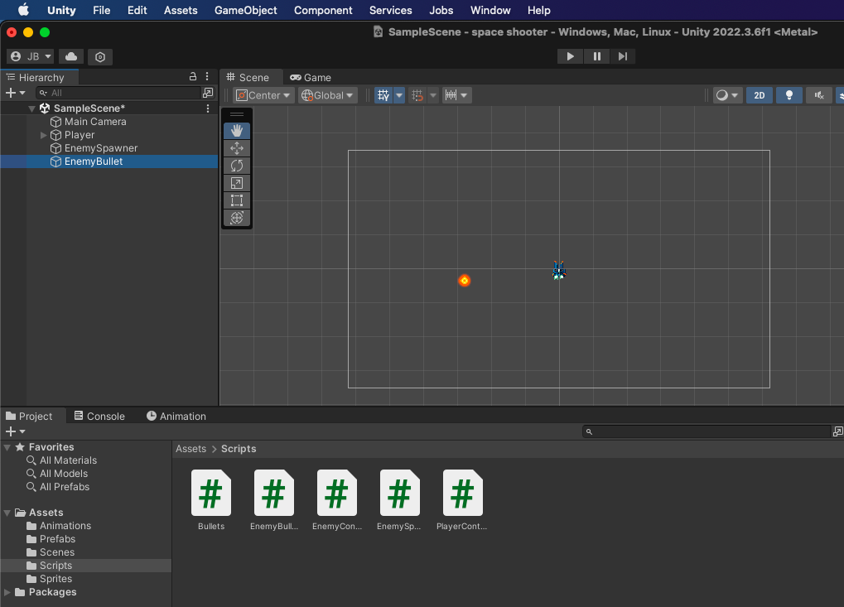
Reference

Slide 29
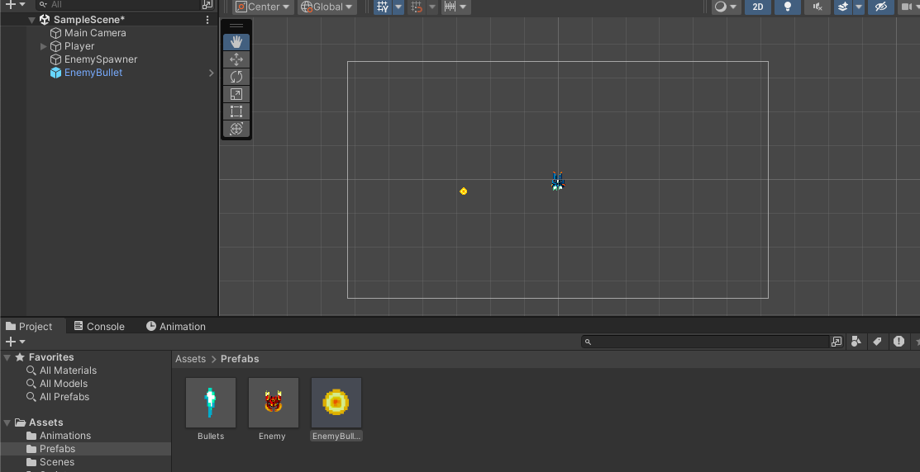
Make the Prefab
DRAG the EnemyBullet game object in the Prefabs folder
Delete the EnemyBullet in the Hierarchy

Slide 30
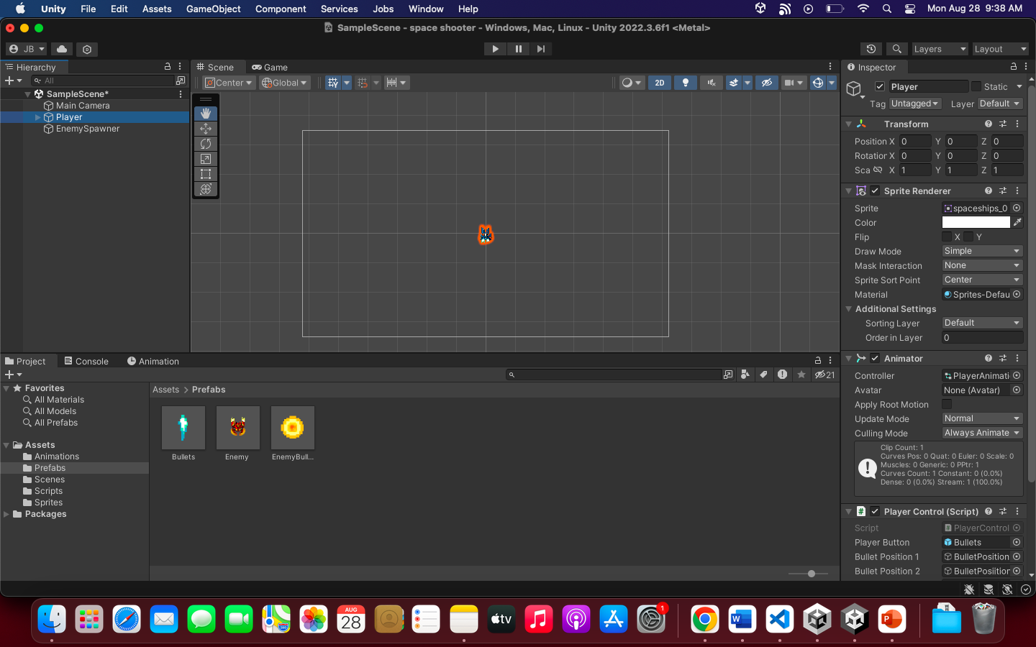
Hide the Player
Hide the “Player”. Inspector uncheck the checkbox
Drag the “Enemy” prefab to the Hierarchy. Reset the position
Create empty game object named it: “EnemyGun”
Set the position to:
X: -0.006 Y: -0.185 Z: 0.06209062
You should have this by now:

Slide 31
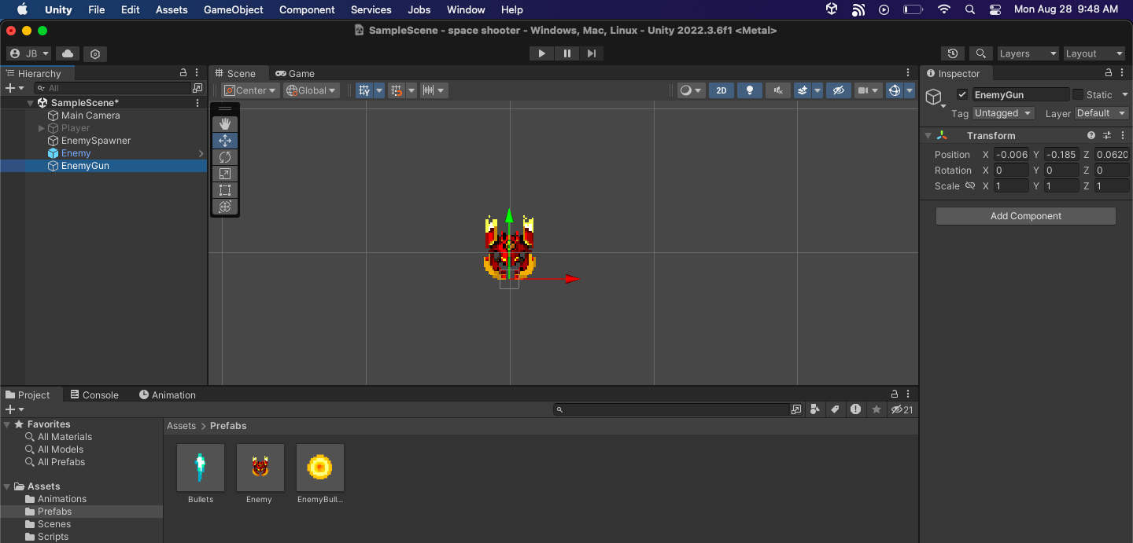
Reference
Drag the “EnemyGun” inside the Enemy Game Object (which is already a prefab by now)
See reference in the next slide

Slide 32

Make EnemyGun a layer under Enemy Prefab

Slide 33
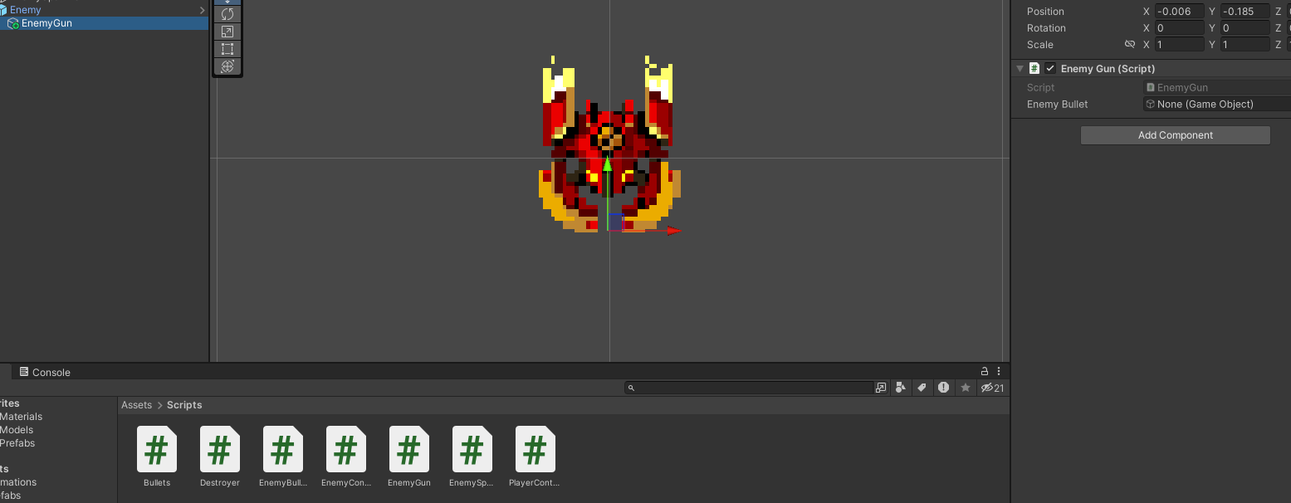
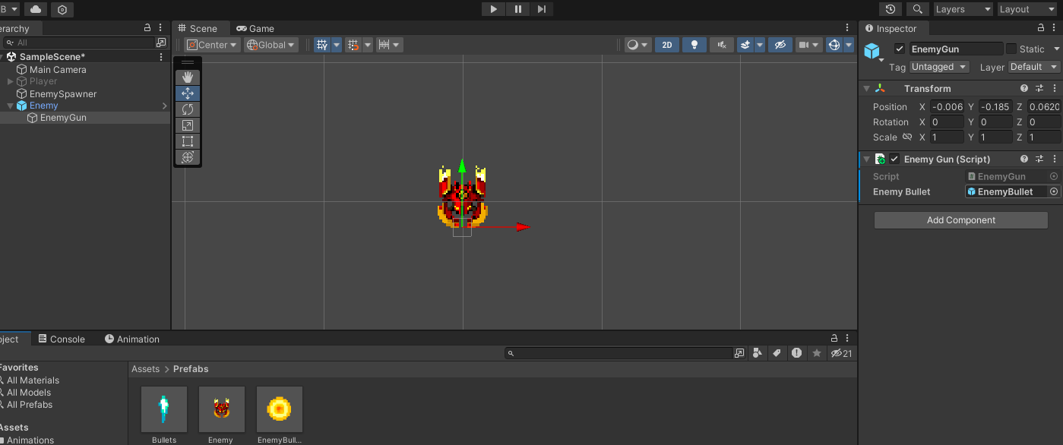
Enemy Gun Script
Drag the ”EnemyGun.cs” to the “EnemyGun” game object/prefab
Drag the Prefab “EnemyBullet” to the slot of the script in Inspector

Slide 34
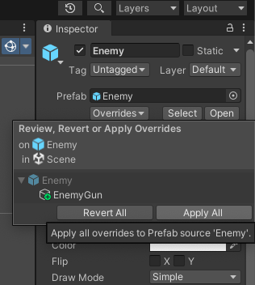
Saving a Prefab
Click on Enemy in the Hierarchy
Save the Prefab by clicking “Overrides” and click “Apply All”
DELETE the Enemy Prefab after applying changes

Slide 35
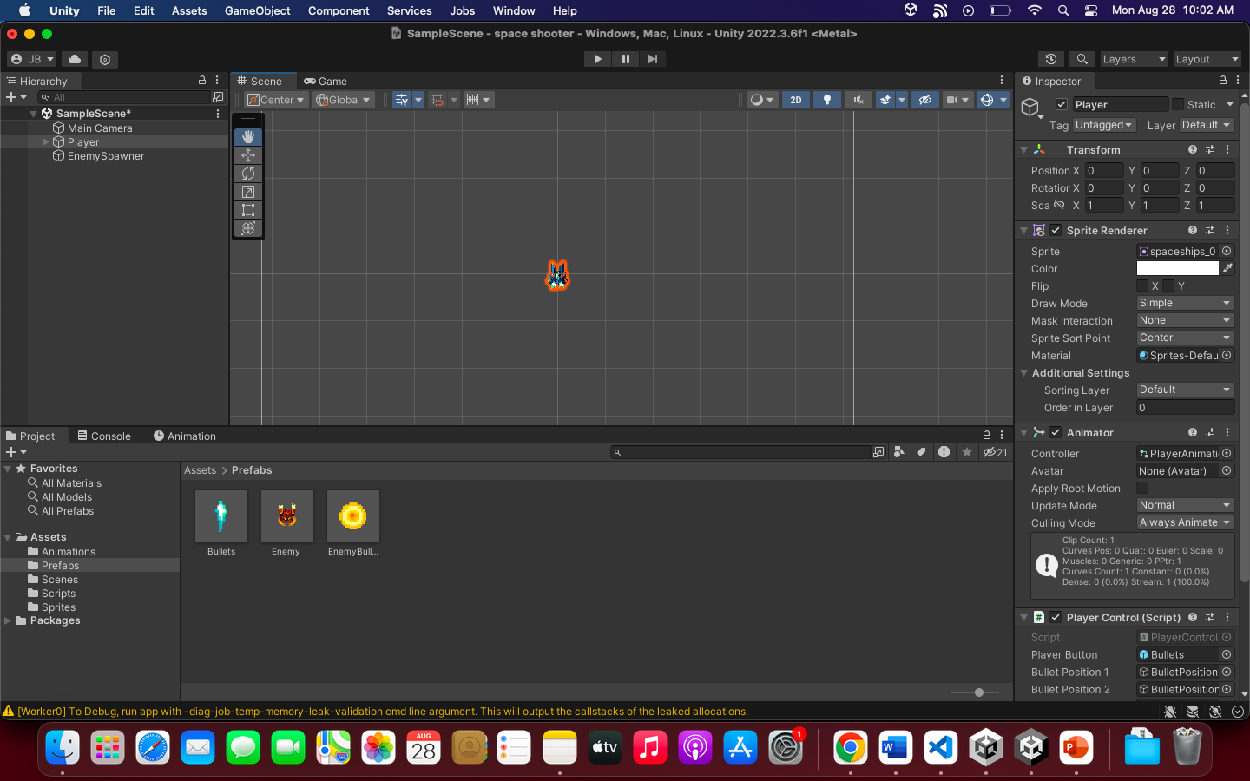
Make the player visible again
Check the visibility of the Player to test the game

Slide 36
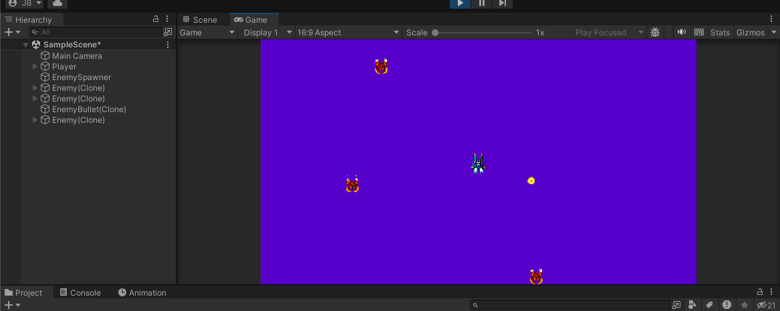
RUN THE GAME

Slide 37
#6: Final – Collisions and Explosions

Slide 38
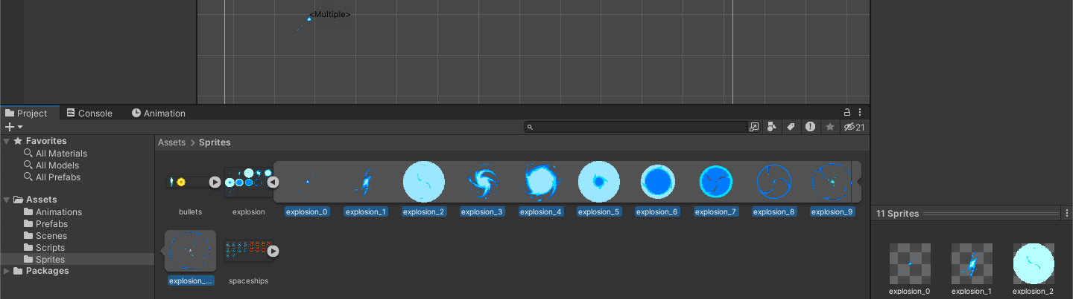
Select explosion, then select the sprites of the enemy:
Drag the selected sprites to the Scene View.
Animation will be created. Name it: ExplosionAnimations. Save it to Animation Folder
Name the controller to: ExplosionAnimationController

Slide 39
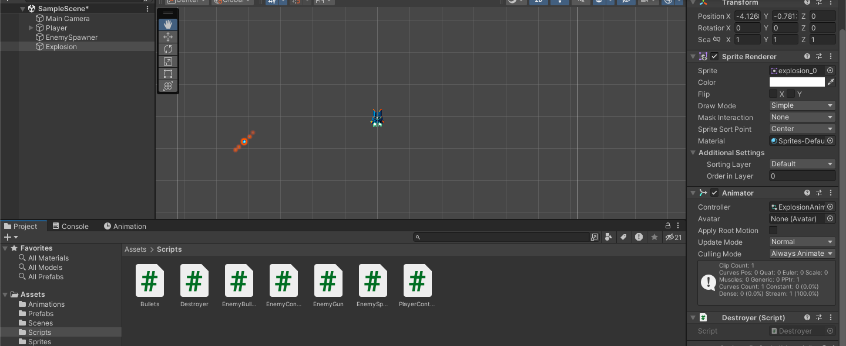
Setup
Rename the dragged game object to “Explosion”
Drag the Destroyer.cs to the Explosion game object

Slide 40
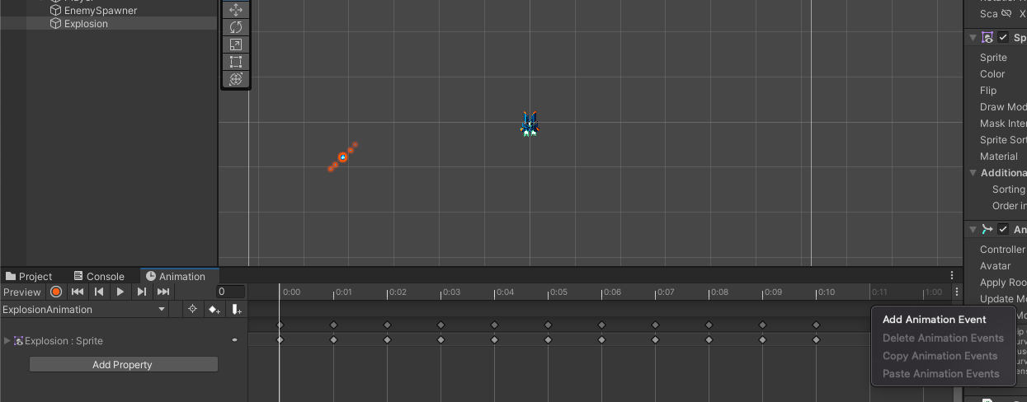
Setup the Animation
Select ”Explosion” game object
Go to “Animation” tab
BELOW 0.11 ms, right click and select “Add Animation Event”

Slide 41
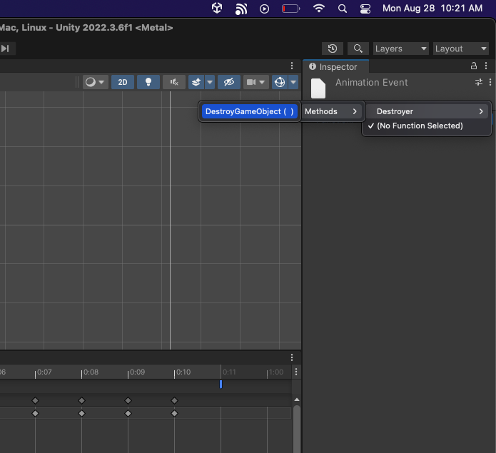
Setup the Animation
In the Inspector, go to Function.
Select Function. Choose Destroyer. Choose Methods. Select ”DestroyerGameObject()”

Slide 42
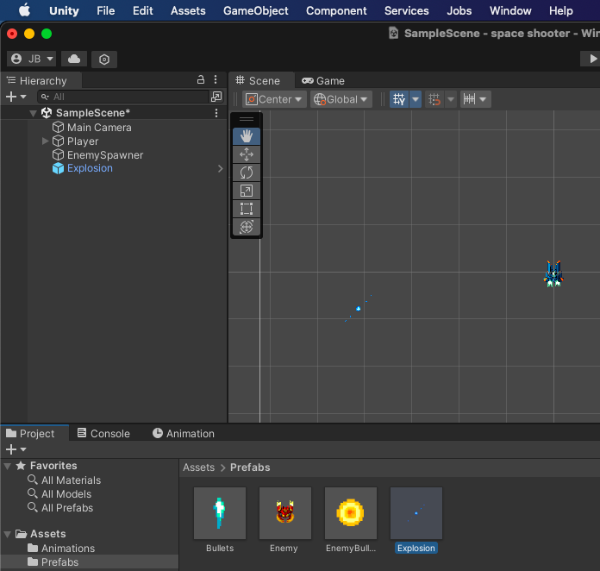
Explosion’s Prefab
Drag the Explosion to the Prefab folder
Delete the Explosion Game Object in the Hierarchy after it became a Prefab

Slide 43
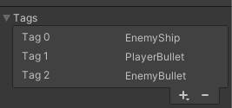
Create Tags
Select the Player game object
Create tags: EnemyShip, PlayerBullet, EnemyBullet
Apply the tags to the game objects and prefabs
Player = Player
Enemy (Prefab) = EnemyShip
Bullets (Prefab) = PlayerBullet
EnemyBullet (Prefab) = EnemyBullet

Slide 44
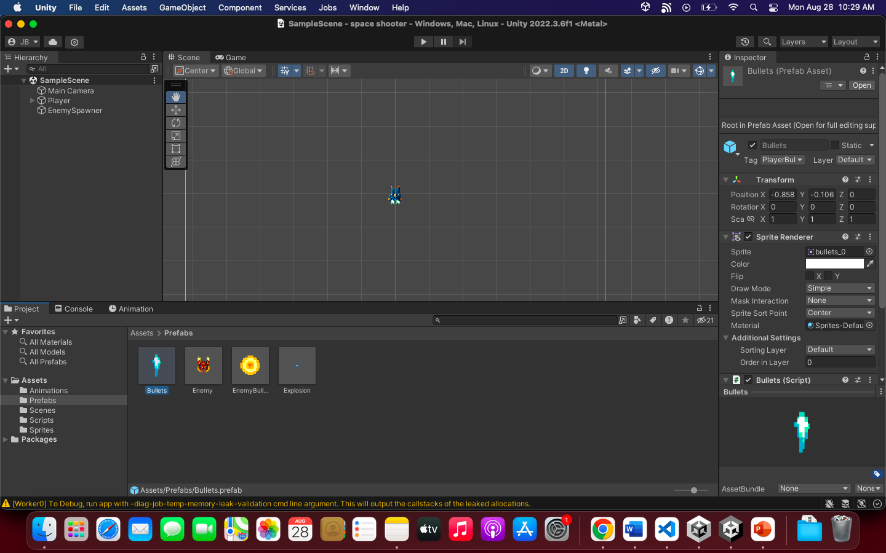


Reference:

Slide 45
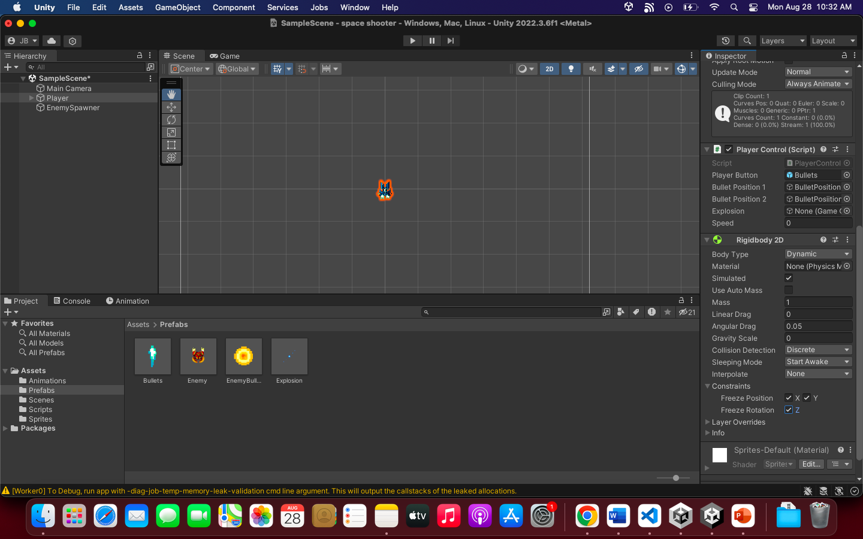
Collisions
For the Player and Prefabs, APPLY RigidBody2D and BoxCollider2d. EXCEPT FOR THE EXPLOSION PREFAB
(CircleCollider2D for the enemy bullet, since the shape is circle)
For RIGIDBODY2D, Setup this settings:
Gravity Scale = 0
Constraints = Freeze all: X,Y,Z by checking the checkboxes

Slide 46
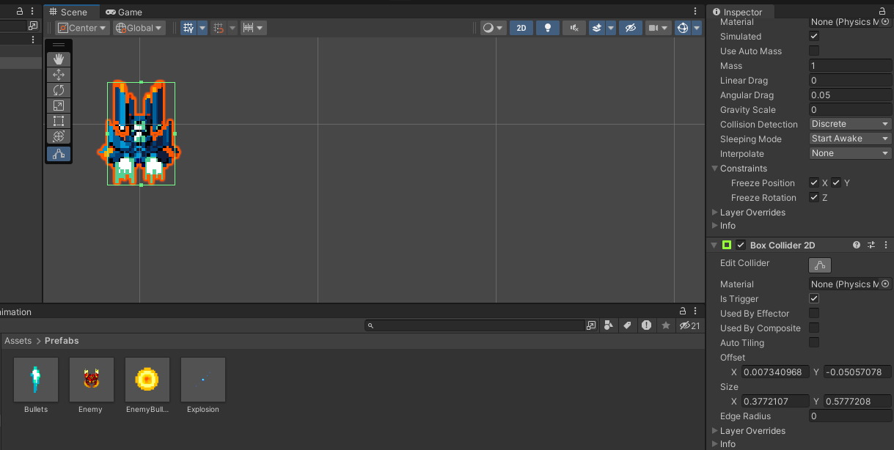
Collisions
Add BoxCollider2D or CircleCollider2D depends on the shape of your object
Check the isTrigger
Adjust the size of the collider. Do the same thing for the other Prefabs

Slide 47
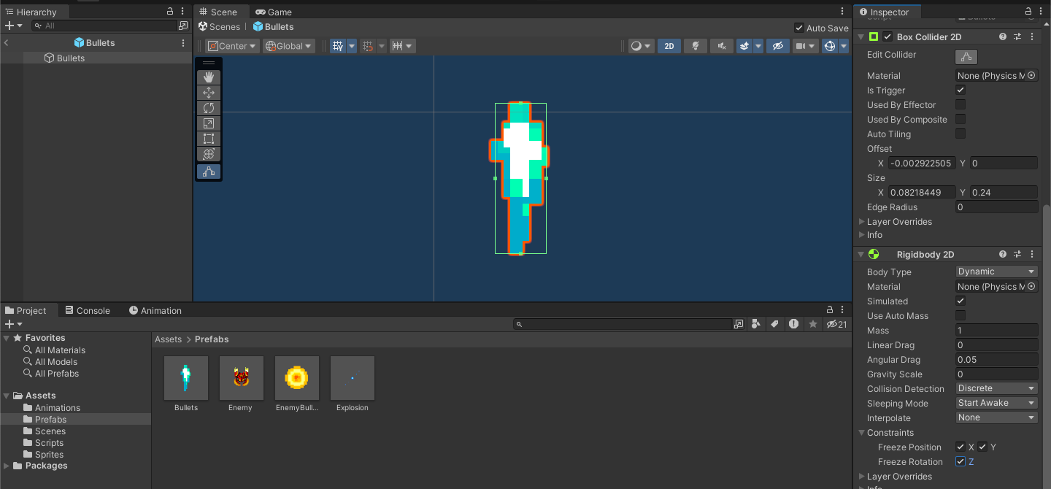
Prefabs
For the Prefabs. In enable to edit collider, just DOUBLE CLICK the prefab and apply the same settings you’ve did just like the Player

Slide 48
Apply Explosions
Drag the ”Explosion” prefab to the script/slot of:
PLAYER
ENEMY

Slide 49
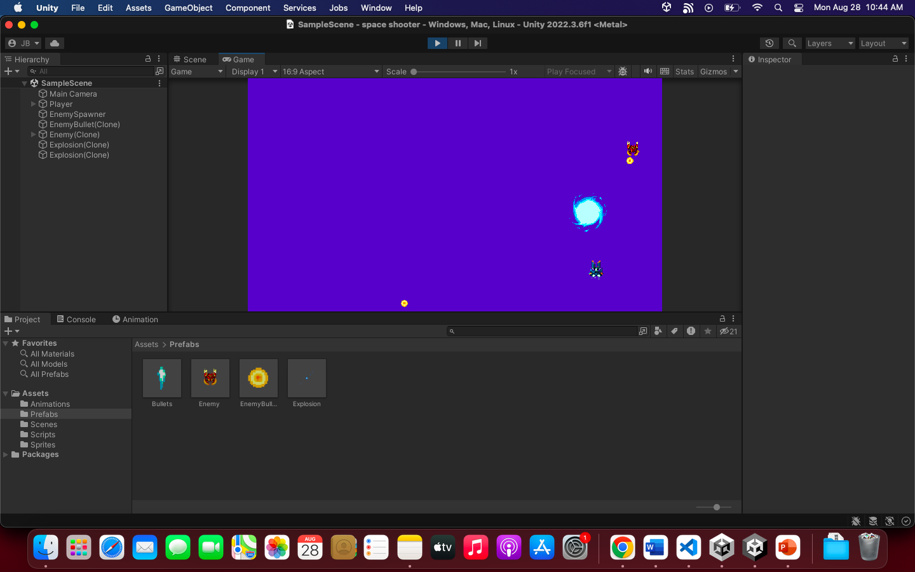
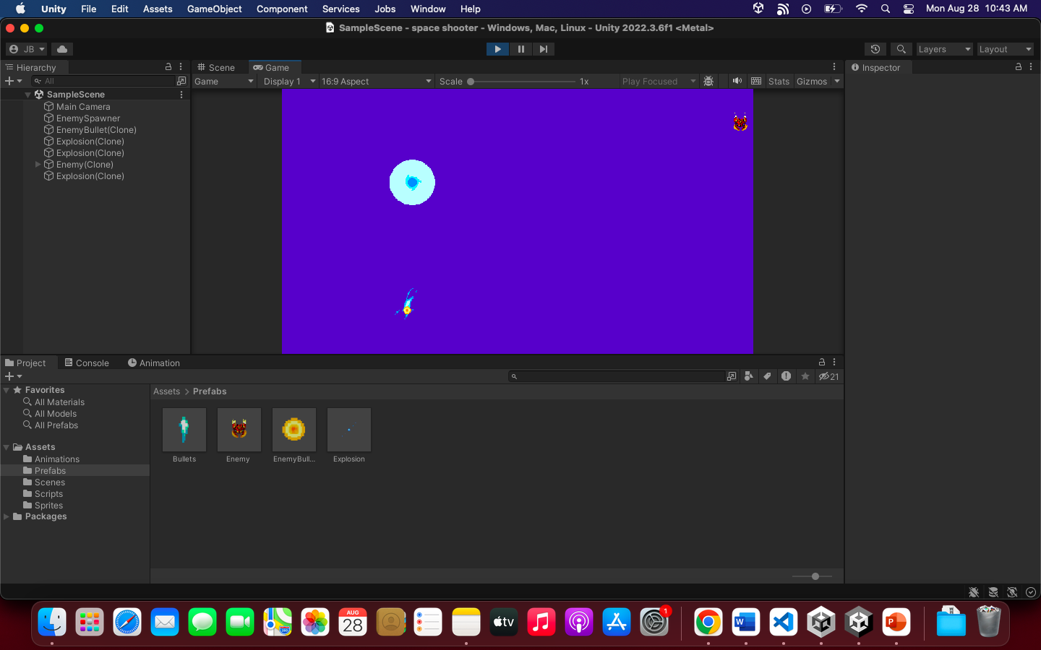
THE GAME IS FINISHED

